Slide 1


TWITTER SENTIMENT ANALYSIS !
Big Data Anaytics !

Slide 2
TABLE OF CONTENTS
01
02
03
04
PROBLEM STATEMENT
INTRODUCTION
LITERATURE SURVEY
DATA COLLECTION
05
FLOW GRAPH
06
LIBRARIES
07
PREPROCESSING
08
OUTPUT SCREENSHOT
09
CONCLUSION

Slide 3
PROBLEM STATEMENT!
Large Twitter datasets will be analysed using Python and Power BI for this project.
The data must be pre-processed to remove pertinent information like user IDs,
hashtags, and timestamps. A list of popular subjects, trends, and the tone
of the tweets will be the result in the end

Slide 4
INTRODUCTION
Twitter Sentiment analysis is the process of understanding how people are using Twitter and how it affects people's lives and it will tell that tweet is positive(or)negative(or)neutral. Python and Power BI are two powerful tools that can help in this process.

Slide 5
DATA COLLECTION
The first step in performing Twitter analysis is to collect the data. This is done by using the Twitter API or by scraping the website. The data collected can include tweets, Polarity, Subjectivity and Score.
Once the data is collected, it must be cleaned and organized. This involves removing any irrelevant or duplicate data, and formatting the data for analysis.

Slide 6
FLOWGRAPH
collecting keys and tokens from Twitter developer account.
Using kamalaHarris Twitter account we are collecting Tweets.
Installing tweepy and Textblob
Analysis dataframe using Score.
Preprocessing dataframe.
Creating datafram
Defining Subjectivity and Polarity.
Importing libraries
At last we done Plotting.
Importing that keys and tokens.

Slide 7
Libraries used in this project are Tweepy TextBlob

Slide 8
PREPROCESSING
In this project we collected data from Twitter Api and Done preprocessing in python by using cleanUpTweet technique.

Slide 9
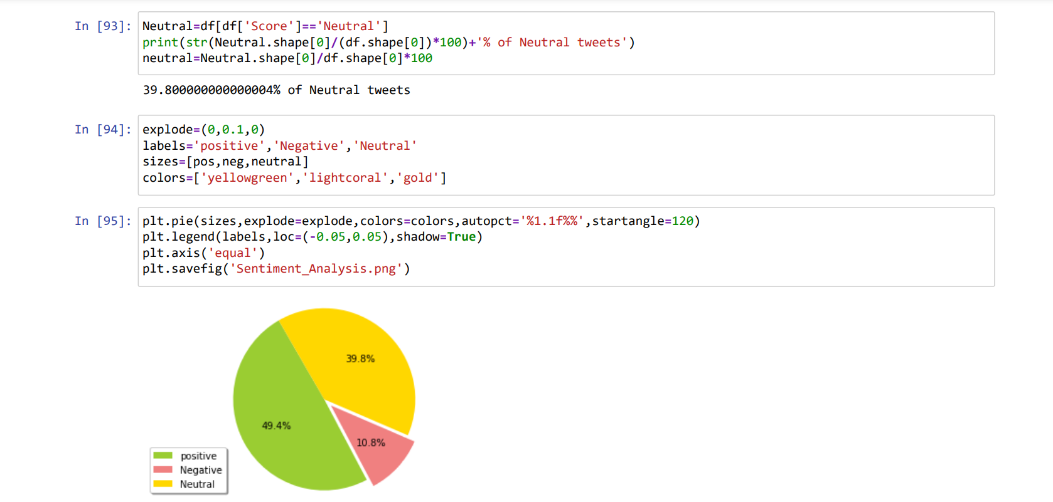
OUTPUT SCREENSHOTS

Slide 10
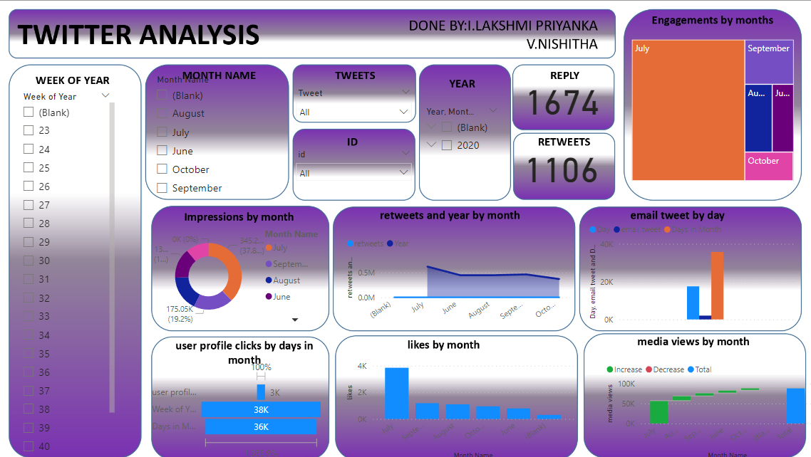
OUTPUT SCREENSHOTS POWER BI

Slide 11
CONCLUSION
Twitter analysis using Python and Power BI is a powerful way to gain insights into Tweet, subjectivity, polarity. By collecting, cleaning, analysing, processing, and visualizing the data, it is possible to gain valuable insights into if the tweet is positive or negative or neutral.

Slide 12

THANK YOU

